Slide 1
Theories of Production
Copyright@ Ashis Kumar Pradhan
ALLPPT.com _ Free PowerPoint Templates, Diagrams and Charts

Slide 2
Law of Variable Proportion
This law supports short-run production function. This is also known as the law of diminishing returns.
In the short-run the level of production can be changed by changing the factor proportions.
This law examines the production function with one factor variable, keeping the other factors quantities fixed.
Total Product- It is total output resulting from the efforts of all the factors of production combined together at any time.
2. Average Product- It is the total product per unit of the variable factor.
3. Marginal Product- It is the change in the total product per unit of change in the variable factor.

Slide 3
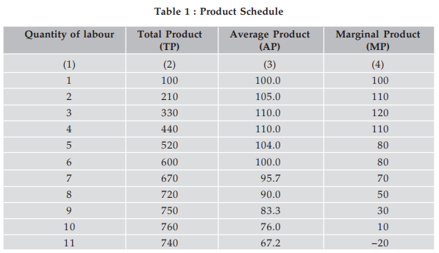
Product Schedule
The total product goes on rising as more and more units of labour were employed.
Relationship between Average Product and Marginal Product
When average product rises as a result of an increase in the quantity of variable input, marginal product is more than the average product.
When average product is maximum, marginal product is equal to average product. Marginal product curve cuts average product from its maximum.
When average product falls, marginal product is less than the average product.

Slide 4
Assumptions
1. The state of technology is assumed to be given and constant.
2. There must be some inputs whose quantity is kept fixed.
3. The law is not applied to those cases where the factors must be used in fixed proportions to yield output..
4. We consider only the physical inputs and outputs and not economic profitability in monetary terms.

Slide 5
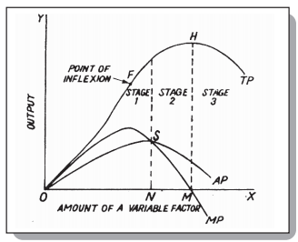
The law states that as we increase the quantity of one input which is combined with other fixed inputs, the marginal product of the variable input must eventually decline. In other words, an increase in the variable inputs, given the state of technology, cause output to increase, but after certain point the additional output resulting from the same addition of extra inputs become less and less.

Slide 6
Stages of the Law of Variable Proportion
Stage 1: Law of increasing returns
In this stage, total product increases at an increasing rate upto point F and then increases at a diminishing rate until the end of stage 1. Marginal product also rises and reaches its maximum at point F and the average product curve continues to rise. After point F the marginal product starts falling but remains positive. At the end of stage 1 average product curve reaches at its maximum.
Stage 2: Law of diminishing returns
In this stage, the total product continues to increase at a diminishing rate until it reaches its maximum point H, where the second stage ends. Both average product and marginal product falls throughout but remains positive. At the end of the stage the marginal product of the variable factor becomes zero while the total product reaches its maximum.
Stage 3: Law of negative returns
In this stage, total product declines, marginal product turns negative and average product continues to decline. This stage is called the stage of negative returns because the marginal product of the variable factor is negative during this stage.

Slide 7
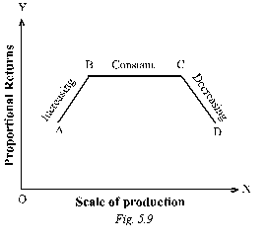
Law of Returns to Scale
This law studies the production in a long run.
It is the study of changes in output when all factors of production in a particular production function are increased together. Or what is the behaviour of output in response to a change in scale.
Increasing returns to scale: The output increases in a greater proportion than the increase in inputs.
Constant returns to scale: It means that with the increase in the scale in some proportion, output increases in the same proportion. It is also called as “Linear homogeneous production function”.
Diminishing returns to scale: When the output increases in a smaller proportion with an increase in all inputs, decreasing returns are said to prevail.

